Slide 1

Emergency Broadband Benefit
What is the Benefit?
Who Is Eligible?
How Can Households Apply?
FCC Partner Toolkit
MarylandꢀCentersꢀForꢀIndependentꢀLiving
SouthernꢀMaryland
Monday,ꢀMayꢀ24,ꢀ2021
2:00ꢀPMꢀ(EST)ꢀ

Slide 2
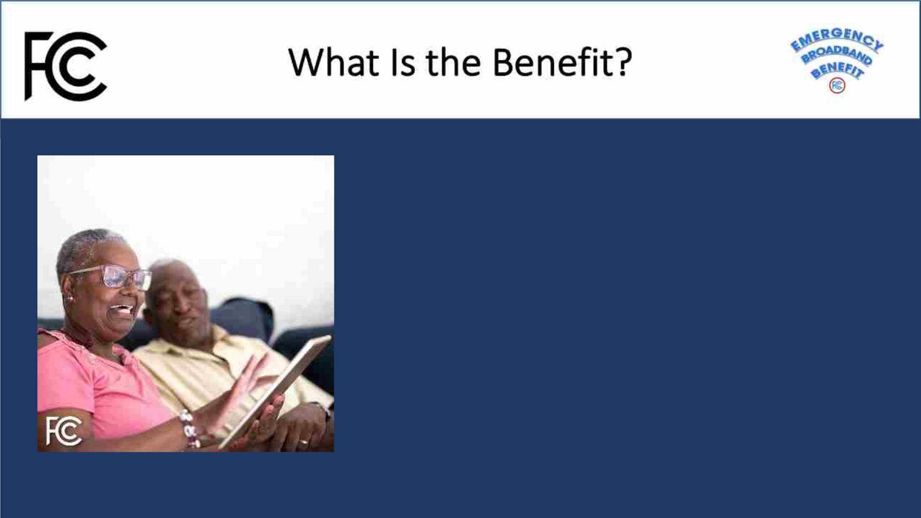
TheꢀEmergencyꢀBroadbandꢀBenefitꢀProgramꢀisꢀaꢀFederalꢀ
CommunicationsꢀCommissionꢀ(FCC)ꢀProgramꢀthatꢀprovidesꢀaꢀ
temporaryꢀdiscountꢀonꢀmonthlyꢀbroadbandꢀbillsꢀforꢀ
qualifyingꢀlow-incomeꢀhouseholds.ꢀEligibleꢀhouseholdsꢀcanꢀ
receive:
• Upꢀtoꢀ$50/monthꢀdiscountꢀforꢀbroadbandꢀserviceꢀandꢀ
associatedꢀequipmentꢀrentals;
• Upꢀtoꢀ$75/monthꢀdiscountꢀforꢀhouseholdsꢀonꢀTribalꢀ
lands,ꢀand;
• Aꢀone-timeꢀdiscountꢀofꢀupꢀtoꢀ$100ꢀforꢀaꢀlaptop,ꢀdesktopꢀ
computer,ꢀorꢀtabletꢀpurchasedꢀthroughꢀaꢀparticipatingꢀ
provider.

Slide 3

AꢀHouseholdꢀisꢀEligibleꢀIfꢀAnyꢀMember
• ReceivedꢀaꢀPellꢀGrantꢀinꢀtheꢀcurrentꢀawardꢀyear;
• Isꢀapprovedꢀtoꢀreceiveꢀbenefitsꢀunderꢀtheꢀfreeꢀandꢀ
reducedꢀschoolꢀlunchꢀprogramꢀorꢀschoolꢀbreakfastꢀ
programꢀinꢀtheꢀ2019-2020ꢀorꢀ2020-2021ꢀschoolꢀyear;
• Experiencedꢀaꢀsubstantialꢀlossꢀofꢀincome,ꢀdueꢀtoꢀaꢀjobꢀlossꢀ
orꢀfurloughꢀsinceꢀ2/29/20ꢀandꢀtheꢀhouseholdꢀhadꢀaꢀtotalꢀ
incomeꢀinꢀ2020ꢀbelowꢀ$99,000ꢀ(singleꢀfilers)ꢀorꢀ$198,000ꢀ
(jointꢀfilers);ꢀor
• Meetsꢀtheꢀeligibilityꢀofꢀaꢀparticipatingꢀproviders’ꢀexistingꢀ
COVID-19ꢀorꢀlow-incomeꢀprogram.

Slide 4
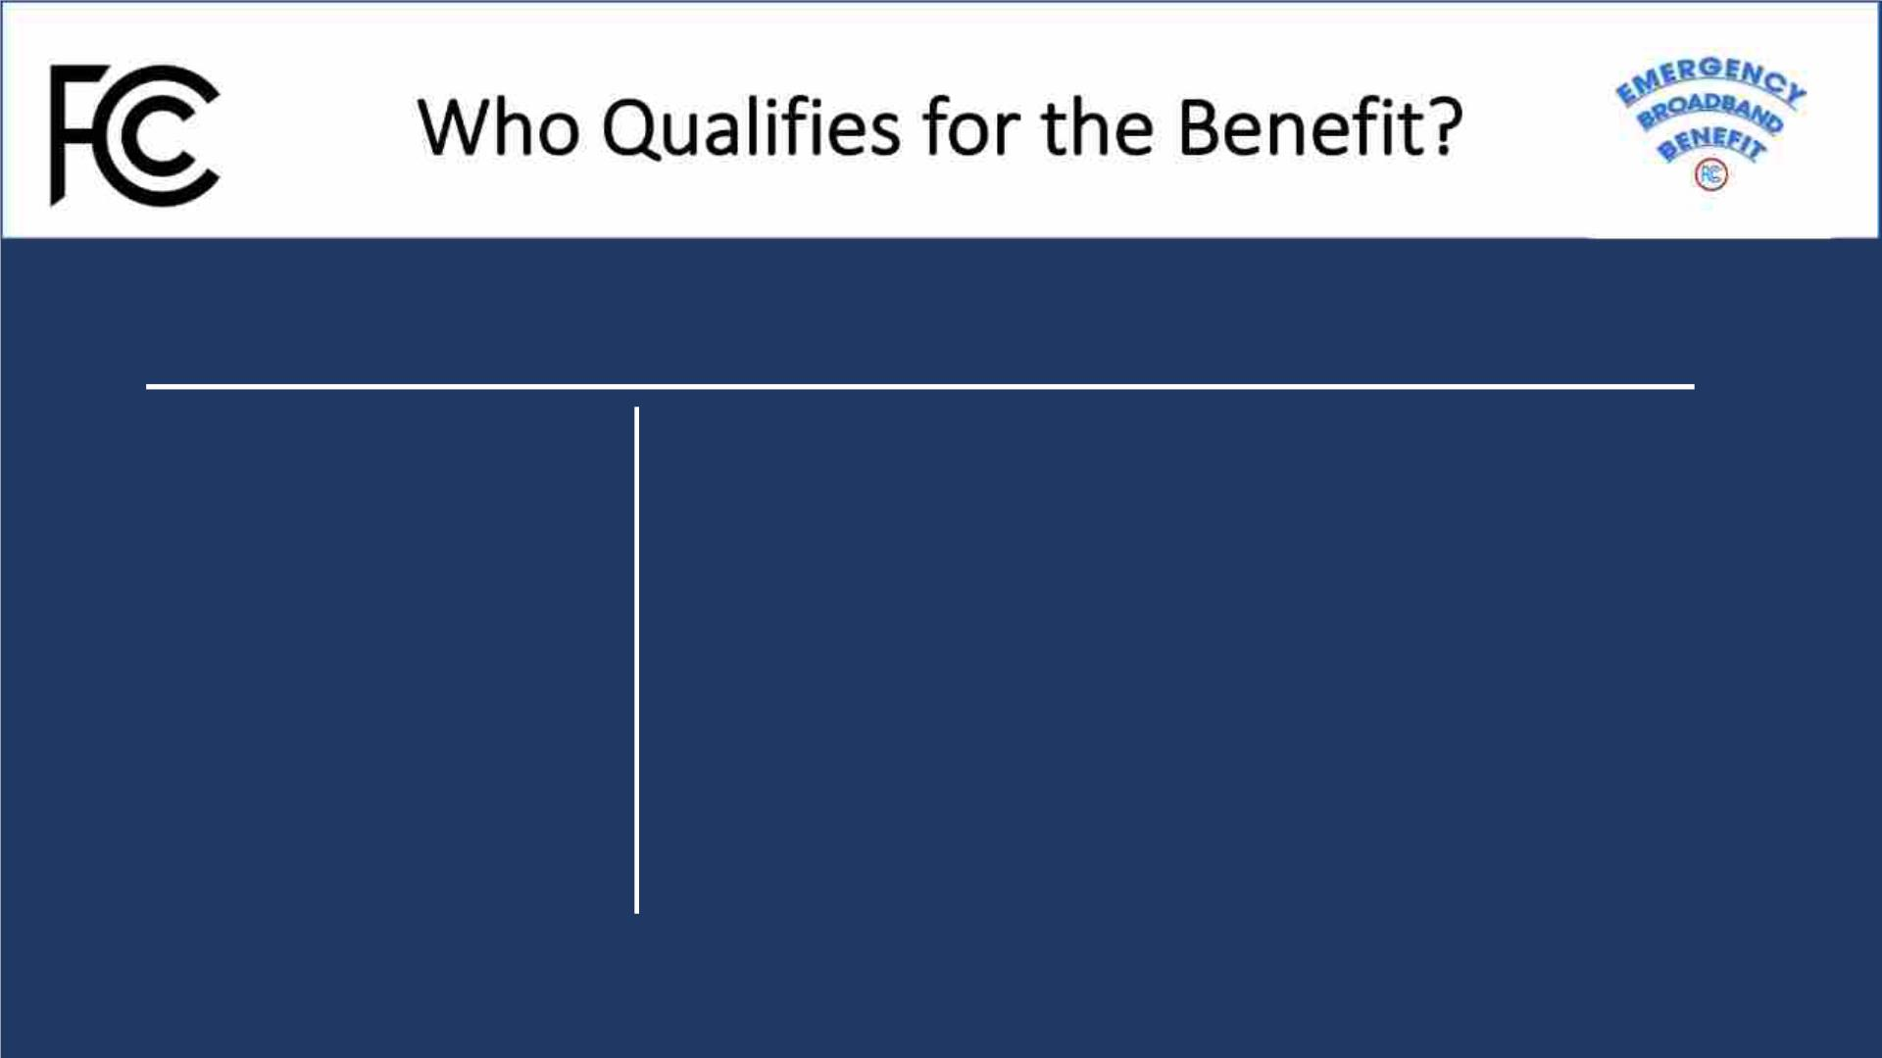
HouseholdsꢀThatꢀQualifyꢀforꢀLifelineꢀAlsoꢀQualify
WhatꢀisꢀLifeline?
HowꢀDoꢀIꢀQualifyꢀforꢀLifeline?
Lifelineꢀisꢀaꢀfederalꢀ
programꢀthatꢀlowersꢀtheꢀ
monthlyꢀcostꢀofꢀphoneꢀandꢀ
internet.ꢀEligibleꢀ
customersꢀwillꢀgetꢀupꢀtoꢀ
$9.25ꢀ(upꢀtoꢀ$34.25ꢀonꢀ
Tribalꢀlands)ꢀtowardꢀtheirꢀ
bill.ꢀ
Householdꢀincomeꢀisꢀlessꢀthanꢀ135%ꢀofꢀtheꢀFederalꢀpovertyꢀguidelines
or
Aꢀmemberꢀofꢀtheꢀhouseholdꢀparticipatesꢀinꢀoneꢀofꢀtheseꢀprograms:
• SupplementalꢀNutritionꢀAssistanceꢀProgramꢀ(SNAP),ꢀformerlyꢀknownꢀ
asꢀFoodꢀStamps
• Medicaid
• SupplementalꢀSecurityꢀIncomeꢀ(SSI)
• FederalꢀPublicꢀHousingꢀAssistanceꢀ(FPHA)
• VeteransꢀPensionꢀandꢀSurvivorsꢀBenefit
• Tribalꢀprogramsꢀ(andꢀyouꢀliveꢀonꢀqualifyingꢀTribalꢀlands)

Slide 5
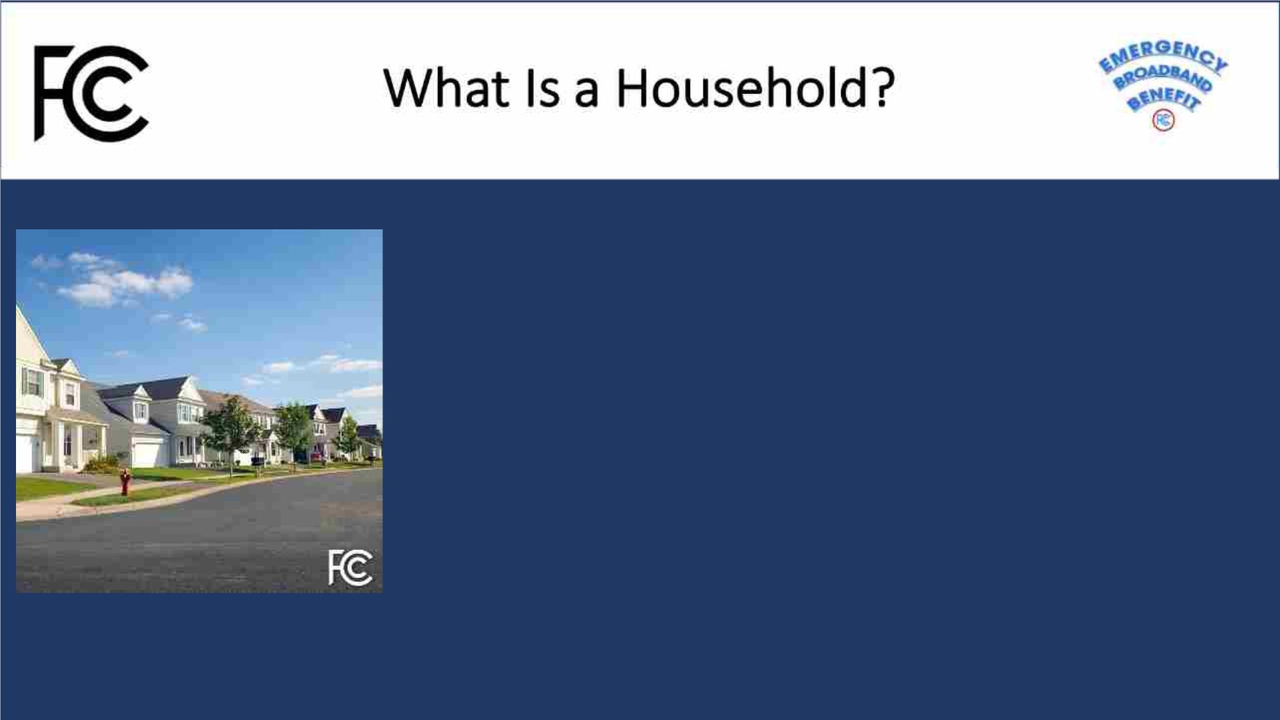
Aꢀhouseholdꢀisꢀaꢀgroupꢀofꢀpeopleꢀwhoꢀliveꢀtogetherꢀandꢀshareꢀmoneyꢀ(evenꢀ
ifꢀtheyꢀareꢀnotꢀrelatedꢀtoꢀeachꢀother.)ꢀꢀIfꢀyouꢀliveꢀtogetherꢀandꢀshareꢀmoney,ꢀ
youꢀareꢀoneꢀhousehold.ꢀꢀIfꢀyouꢀeitherꢀdon’tꢀliveꢀtogetherꢀorꢀyouꢀdon’tꢀshareꢀ
money,ꢀyouꢀareꢀtwoꢀorꢀmoreꢀhouseholds.
• Aꢀhouseholdꢀcanꢀqualifyꢀbecauseꢀofꢀeligibleꢀdependentꢀchildrenꢀthatꢀmeetꢀtheꢀ
eligibilityꢀcriteria.
• Youꢀmayꢀhaveꢀtoꢀanswerꢀquestionsꢀaboutꢀyourꢀhouseholdꢀwhenꢀyouꢀapplyꢀforꢀtheꢀ
EmergencyꢀBroadbandꢀBenefitꢀProgram.ꢀ
• Aꢀhouseholdꢀworksheetꢀwillꢀbeꢀavailableꢀtoꢀassistꢀinꢀdeterminingꢀhouseholdꢀ
eligibility.

Slide 6

Eligibleꢀhouseholdsꢀwithinꢀmulti-unitꢀdwellingsꢀsuchꢀasꢀapartmentꢀ
buildings,ꢀnursingꢀhomes,ꢀandꢀgroupꢀhomesꢀcanꢀalsoꢀtakeꢀadvantageꢀofꢀ
theꢀbenefit.
• Householdsꢀwithinꢀmulti-unitꢀdwellings,ꢀwhereꢀtheꢀlandlordꢀorꢀtheꢀpropertyꢀ
managerꢀisꢀtheꢀinternetꢀaccountꢀholder,ꢀmayꢀbeꢀableꢀtoꢀapplyꢀtheꢀbenefitꢀtoꢀ
thatꢀbroadbandꢀserviceꢀifꢀtheyꢀotherwiseꢀqualify.
• Ifꢀtheꢀhouseholdꢀhasꢀaꢀbillꢀorꢀotherꢀliabilityꢀforꢀtheirꢀbroadbandꢀaccessꢀthatꢀ
someoneꢀelse,ꢀsuchꢀasꢀtheꢀpropertyꢀowner,ꢀisꢀhelpingꢀtoꢀpay,ꢀtheꢀhouseholdꢀ
couldꢀswitchꢀtemporarilyꢀtoꢀusingꢀEBBꢀsupportꢀtoꢀpayꢀforꢀbroadbandꢀserviceꢀ
insteadꢀofꢀrelyingꢀonꢀthatꢀthirdꢀparty’sꢀsupport.

Slide 7

TheꢀEmergencyꢀBroadbandꢀBenefitꢀopenedꢀonꢀMayꢀ12,ꢀ2021.
TheꢀEmergencyꢀꢀBroadbandꢀBenefitꢀisꢀaꢀtemporaryꢀprogramꢀdevelopedꢀinꢀ
responseꢀtoꢀtheꢀCOVID-19ꢀpandemic.ꢀTheꢀprogramꢀwillꢀendꢀonceꢀtheꢀ
programꢀfundsꢀareꢀexhausted,ꢀorꢀsixꢀmonthsꢀafterꢀtheꢀDepartmentꢀofꢀHealthꢀ
andꢀHumanꢀServicesꢀdeclaresꢀandꢀendꢀtoꢀtheꢀpandemic,ꢀwhicheverꢀcomesꢀ
first.ꢀ
TheꢀꢀprogramꢀisꢀadministeredꢀbyꢀtheꢀUniversalꢀServiceꢀAdministrativeꢀ
Companyꢀ(USAC).ꢀTheyꢀalsoꢀadministerꢀtheꢀLifelineꢀprogram.ꢀUSACꢀhostsꢀ
theꢀapplicationꢀportalꢀandꢀtheꢀGetEmergencyBroadband.orgꢀconsumerꢀ
website.

Slide 8

• Participatingꢀprovidersꢀmustꢀgiveꢀhouseholdsꢀnoticeꢀaboutꢀtheꢀlastꢀdateꢀorꢀ
billingꢀcycleꢀthatꢀtheꢀfullꢀbenefitꢀwillꢀapplyꢀtoꢀtheirꢀbillꢀandꢀtheꢀdateꢀorꢀbillingꢀ
cycleꢀthatꢀaꢀpartialꢀbenefitꢀwillꢀapplyꢀtoꢀtheirꢀbill,ꢀinꢀadditionꢀtoꢀinformationꢀ
aboutꢀtheꢀcostꢀofꢀbroadbandꢀserviceꢀafterꢀtheꢀprogramꢀends.
• Householdsꢀwillꢀneedꢀtoꢀopt-inꢀorꢀrequestꢀtoꢀcontinueꢀbroadbandꢀservicesꢀwithꢀ
theirꢀprovider.ꢀꢀIfꢀtheyꢀdon’tꢀopt-inꢀorꢀselectꢀaꢀnewꢀserviceꢀplanꢀwithꢀtheꢀ
provider,ꢀtheirꢀbroadbandꢀserviceꢀwillꢀendꢀonceꢀtheꢀprogramꢀends.ꢀEvenꢀifꢀtheyꢀ
hadꢀserviceꢀwithꢀtheꢀsameꢀproviderꢀbeforeꢀenrollingꢀinꢀtheꢀEmergencyꢀ
BroadbandꢀBenefit,ꢀtheyꢀwillꢀneedꢀtoꢀopt-inꢀtoꢀcontinueꢀbroadbandꢀservicesꢀ
afterꢀtheꢀprogramꢀends.

Slide 9
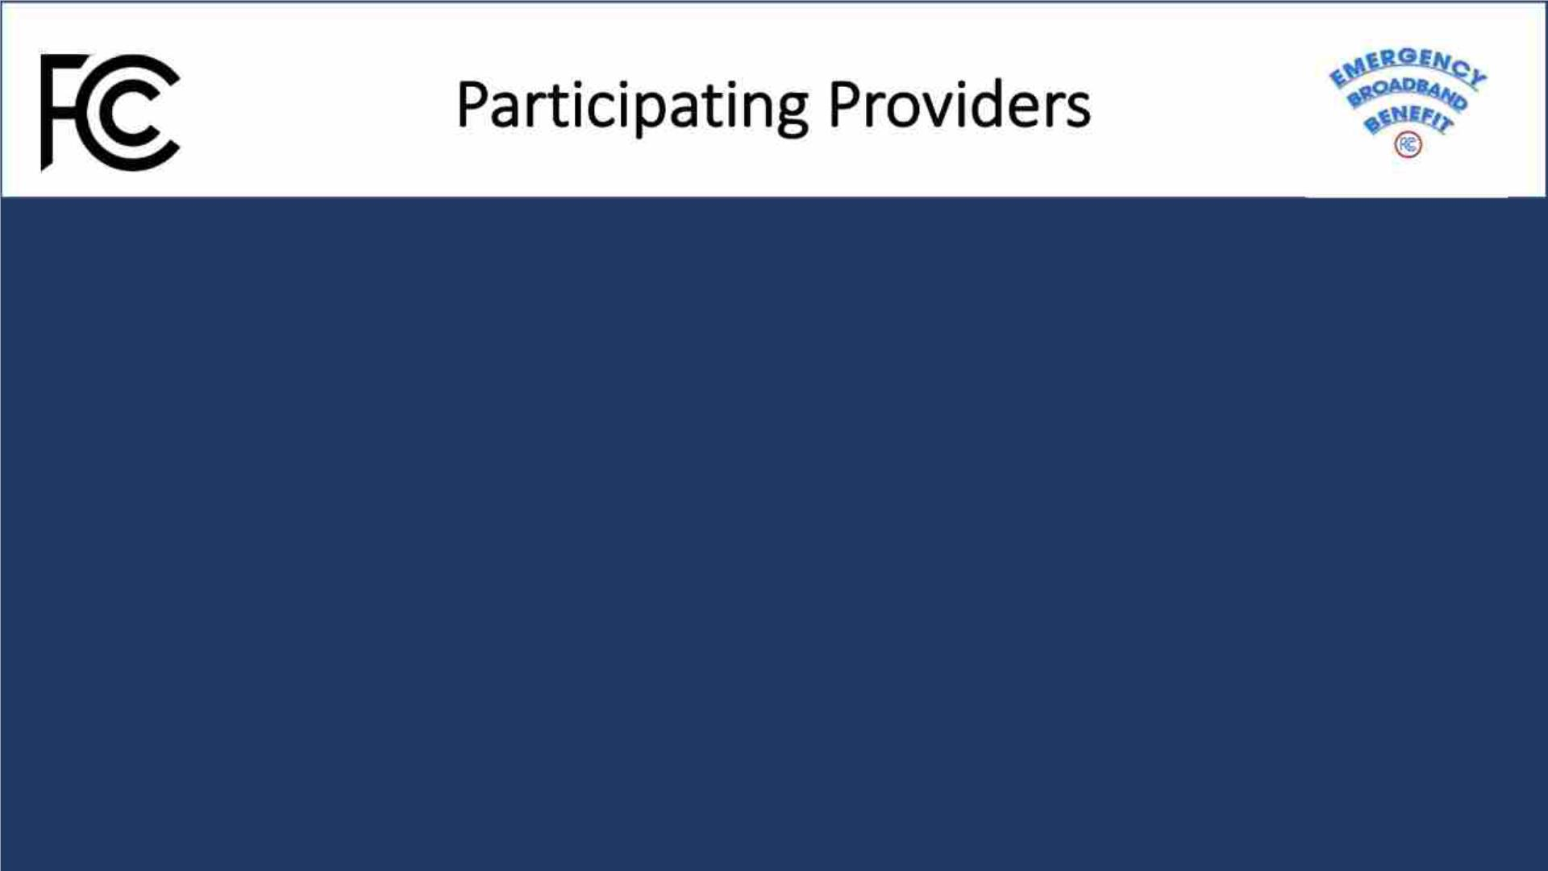
Theꢀprogramꢀisꢀopenꢀtoꢀallꢀbroadbandꢀproviders,ꢀnotꢀjustꢀthoseꢀcurrentlyꢀofferingꢀLifelineꢀ
services.ꢀ
• Fixedꢀbroadbandꢀservicesꢀareꢀprovidedꢀtoꢀyourꢀhome,ꢀorꢀaꢀsingleꢀlocation.ꢀTheseꢀinclude
cable,ꢀfiberꢀoptic,ꢀDSL,ꢀsatellite,ꢀandꢀfixedꢀwirelessꢀservices.
• Mobileꢀbroadbandꢀservicesꢀareꢀdevice-basedꢀandꢀavailableꢀthroughoutꢀtheꢀserviceꢀ
provider’sꢀcellularꢀcoverageꢀarea,ꢀsimilarꢀtoꢀcellꢀphoneꢀservices.
Checkꢀwithꢀtheꢀbroadbandꢀprovidersꢀinꢀyourꢀareaꢀtoꢀlearnꢀaboutꢀtheirꢀplansꢀforꢀprogramꢀ
participationꢀandꢀeligibleꢀserviceꢀofferings.ꢀꢀYouꢀcanꢀfindꢀaꢀlistꢀofꢀparticipatingꢀprovidersꢀbyꢀ
stateꢀandꢀterritoryꢀlinkedꢀonꢀwww.fcc.gov/broadbandbenefit.
Notꢀallꢀprovidersꢀplanꢀtoꢀofferꢀconnectedꢀdevicesꢀthroughꢀtheꢀprogram.

Slide 10
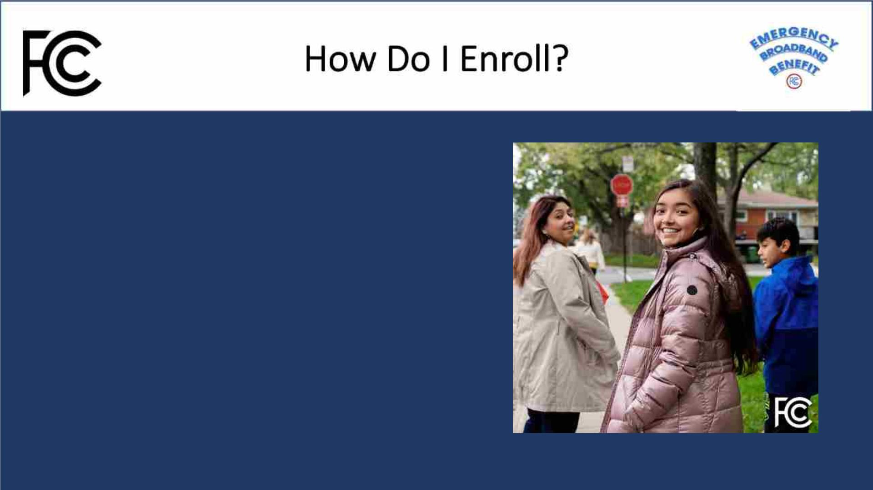
ThereꢀareꢀthreeꢀwaysꢀtoꢀapplyꢀforꢀtheꢀEmergencyꢀ
BroadbandꢀBenefit
Option 1:ꢀꢀContactꢀaꢀparticipatingꢀbroadbandꢀproviderꢀdirectlyꢀ
toꢀlearnꢀaboutꢀtheirꢀapplicationꢀprocess.
Option 2:ꢀꢀGoꢀtoꢀGetEmergencyBroadband.orgꢀ
toꢀapplyꢀonlineꢀandꢀtoꢀfindꢀparticipatingꢀprovidersꢀnearꢀyou.ꢀ
Option 3:ꢀSendꢀaꢀmail-inꢀapplication,ꢀalongꢀwithꢀproofꢀofꢀ
eligibilityꢀto:ꢀ
EmergencyꢀBroadbandꢀ
SupportꢀCenter
P.O.ꢀBoxꢀ7081
London,ꢀKYꢀ40742

Slide 11
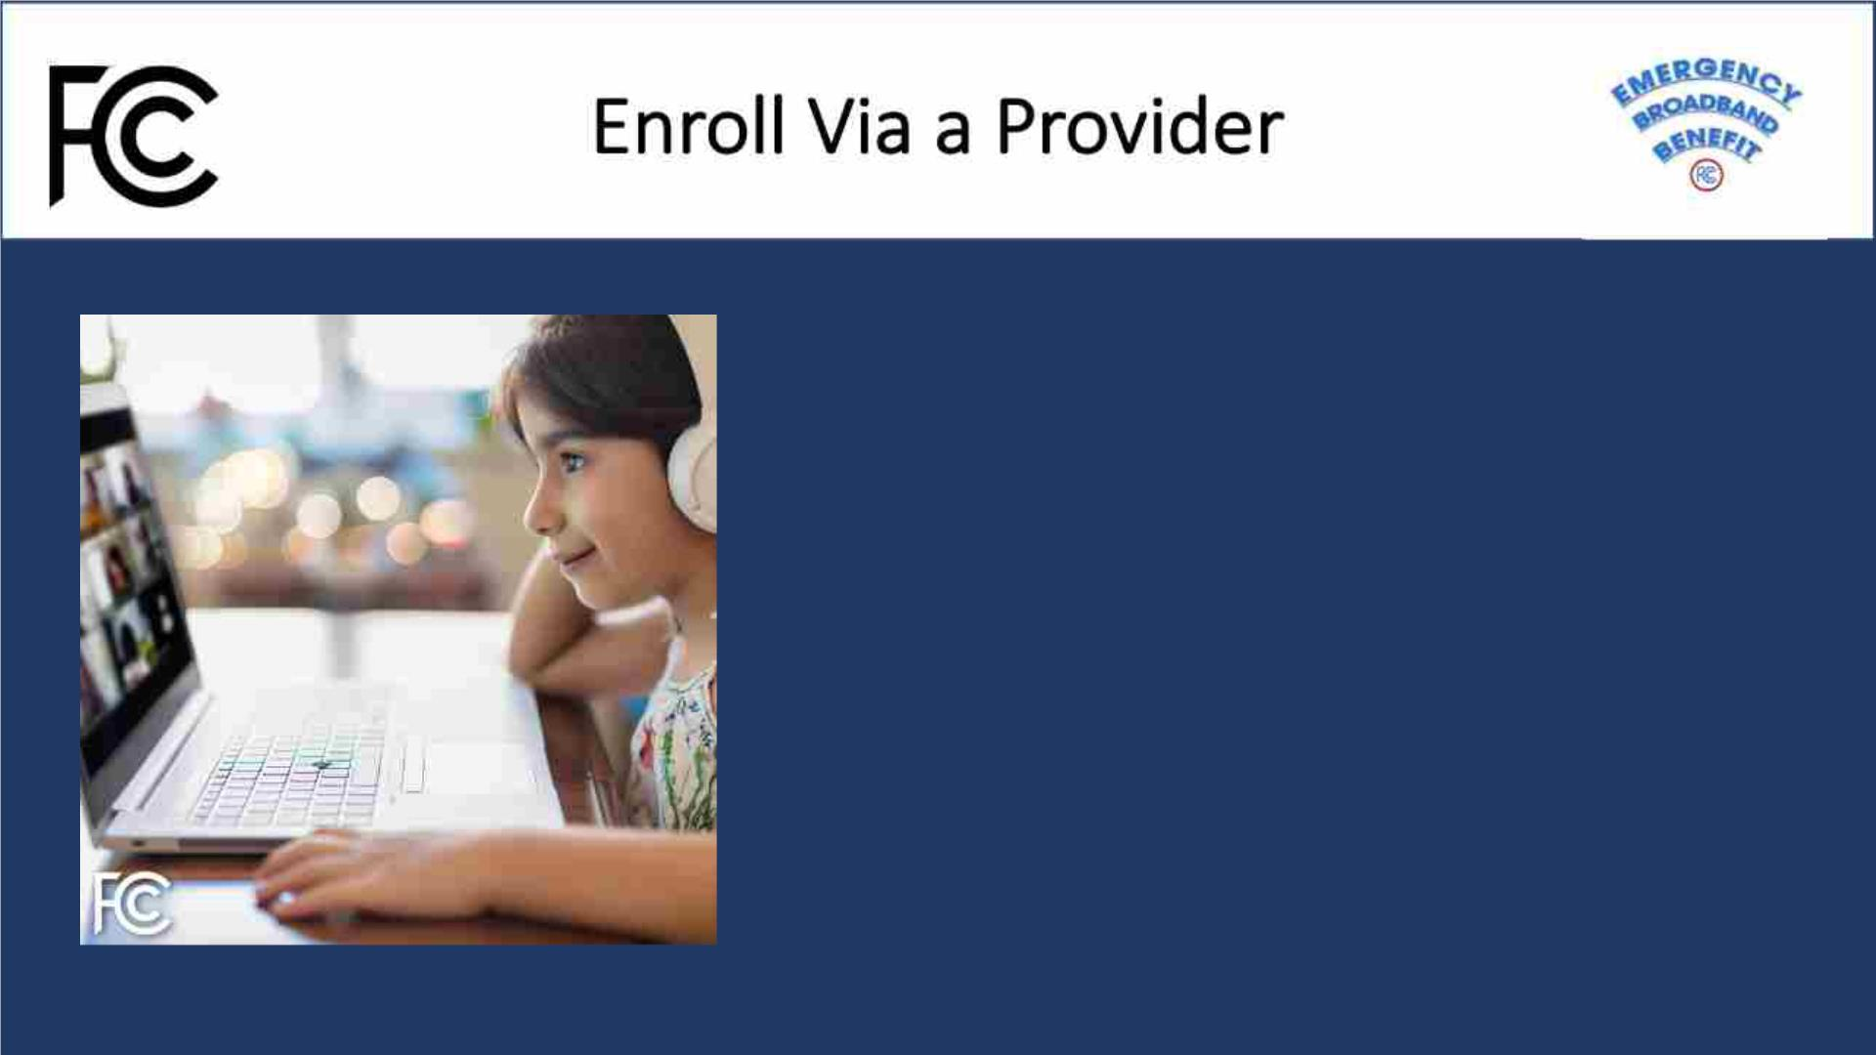
• Contactꢀaꢀserviceꢀprovider.ꢀꢀFindꢀaꢀlistꢀofꢀ
participatingꢀserviceꢀprovidersꢀbyꢀstateꢀat:ꢀ
www.fcc.gov/broadbandbenefit.
• Theꢀserviceꢀproviderꢀassistsꢀtheꢀconsumerꢀ(in-
person)ꢀwithꢀapplyingꢀthroughꢀtheꢀNationalꢀ
VerifierꢀServiceꢀproviderꢀportal;ꢀor
• Theꢀserviceꢀproviderꢀhelpsꢀtheꢀconsumerꢀapplyꢀ
usingꢀtheirꢀFCCꢀapprovedꢀalternateꢀverificationꢀ
process.

Slide 12
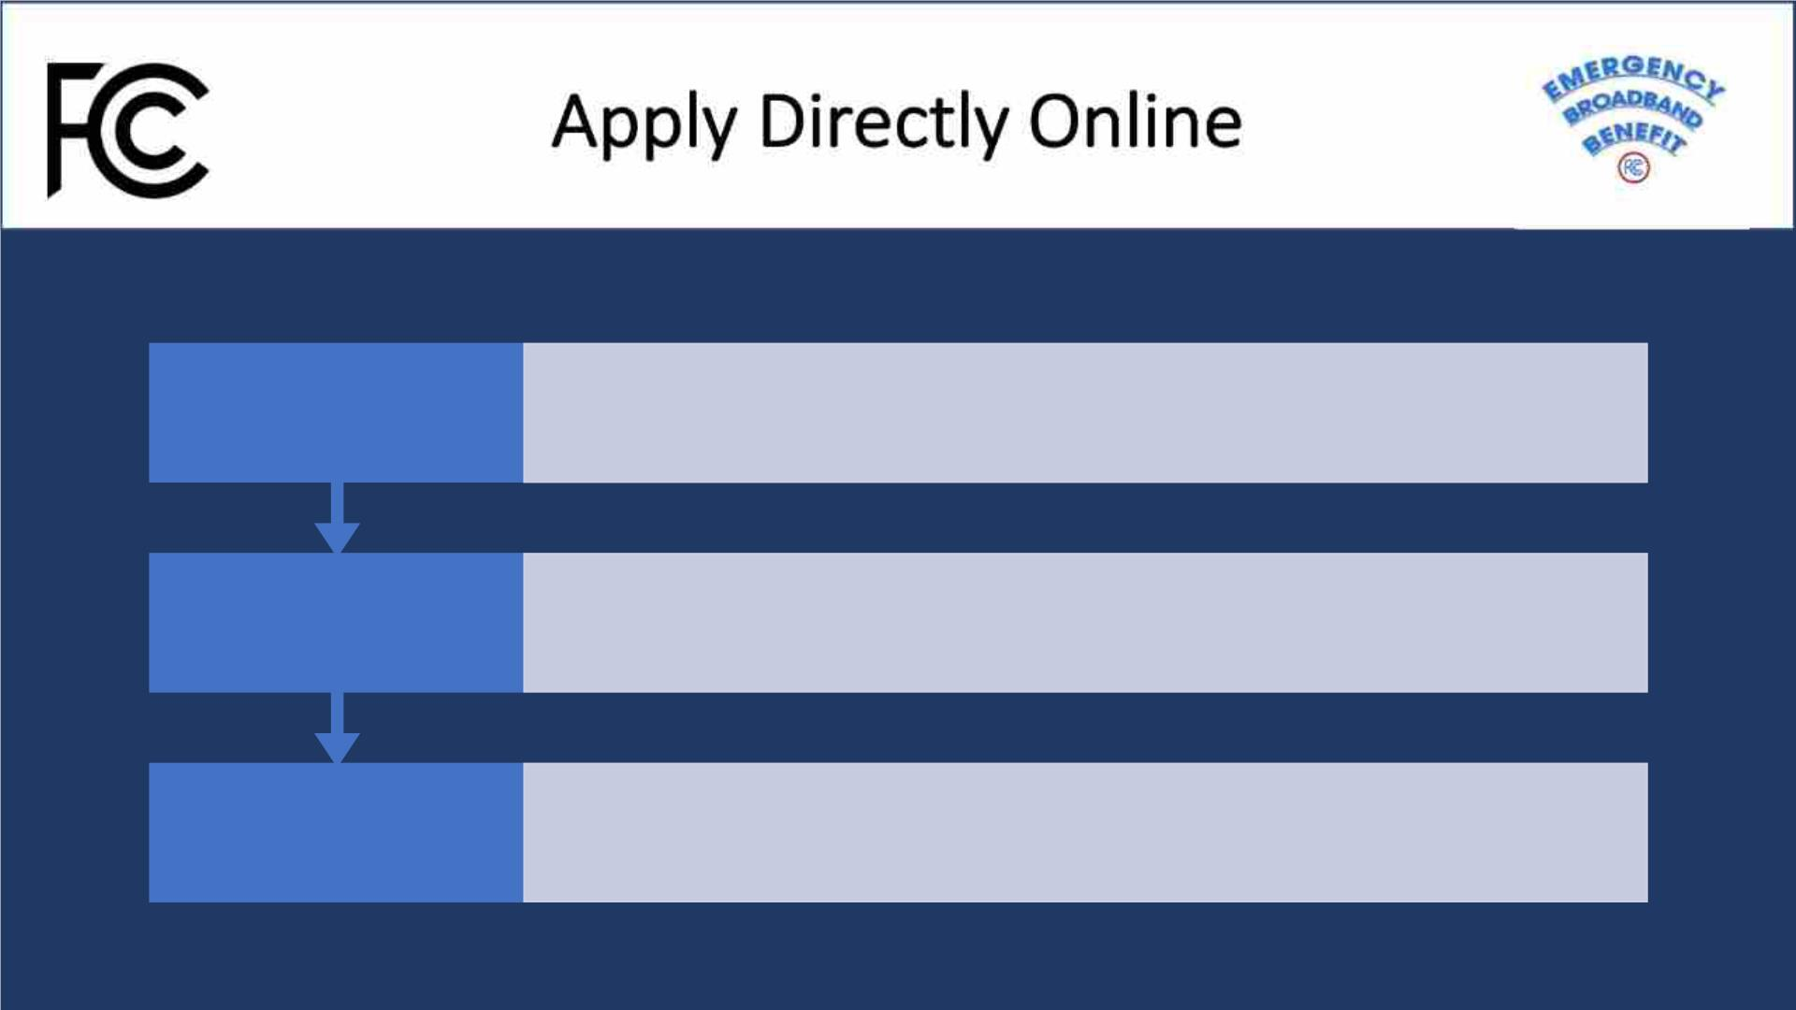
•Visit GetEmergencyBroadband.org
Visit
•Click "How to Apply" and complete the electronic application.
Submit
Contact

Slide 13

• DownloadꢀandꢀprintꢀaꢀpaperꢀapplicationꢀfromꢀGetEmergencyBroadband.org.ꢀꢀ
(Participatingꢀprovidersꢀmayꢀalsoꢀsupplyꢀconsumersꢀwithꢀpaperꢀapplications)
• Mailꢀtheꢀcompletedꢀapplicationꢀto:
EmergencyꢀBroadbandꢀSupportꢀCenter
P.O.ꢀBoxꢀ7081
London,ꢀKYꢀꢀ40742
• Toꢀhelpꢀwithꢀapplicationꢀprocessingꢀincludeꢀsupportingꢀdocumentsꢀtoꢀproveꢀ
eligibilityꢀandꢀtheꢀhouseholdꢀworksheet.

Slide 14

• WhenꢀapplyingꢀforꢀtheꢀEmergencyꢀBroadbandꢀBenefitꢀusingꢀUSAC’sꢀonlineꢀapplication,ꢀtheyꢀ
willꢀattemptꢀtoꢀconfirmꢀyourꢀinformationꢀautomatically.ꢀ
• Onlineꢀandꢀmail-inꢀapplicantsꢀmayꢀbeꢀaskedꢀtoꢀprovideꢀinformationꢀorꢀdocumentationꢀtoꢀ
verifyꢀidentity,ꢀaddress,ꢀorꢀeligibility.ꢀ
• Toꢀconfirmꢀyourꢀeligibility,ꢀadditionalꢀdocumentationꢀcanꢀbeꢀmailedꢀorꢀsubmittedꢀ
electronically.ꢀExamplesꢀofꢀacceptableꢀdocumentsꢀthatꢀcanꢀbeꢀusedꢀtoꢀvalidateꢀinformationꢀ
canꢀbeꢀfoundꢀat:ꢀgetemergencybroadband.org/how-to-apply/show-you-qualify/

Slide 15
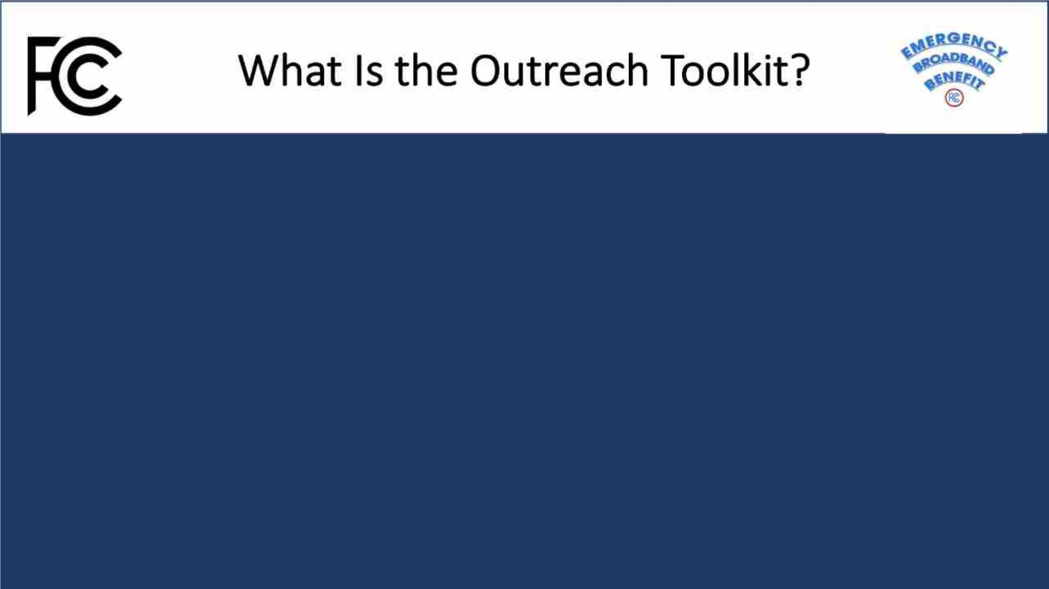
Theꢀoutreachꢀtoolkitꢀisꢀaꢀcollectionꢀofꢀsocialꢀmedia,ꢀprintables,ꢀ
andꢀotherꢀtoolsꢀtoꢀassistꢀcommunities,ꢀpartners,ꢀgrassrootsꢀ
organizers,ꢀandꢀnavigatorsꢀinꢀraisingꢀawarenessꢀaroundꢀtheꢀ
EmergencyꢀBroadbandꢀBenefit.
Theseꢀtoolsꢀareꢀforꢀpublicꢀaccess,ꢀdownloadable,ꢀandꢀfreeꢀtoꢀuse.ꢀ
Theyꢀcanꢀalsoꢀbeꢀco-brandedꢀand/orꢀadjustedꢀtoꢀyourꢀvoice.

Slide 16
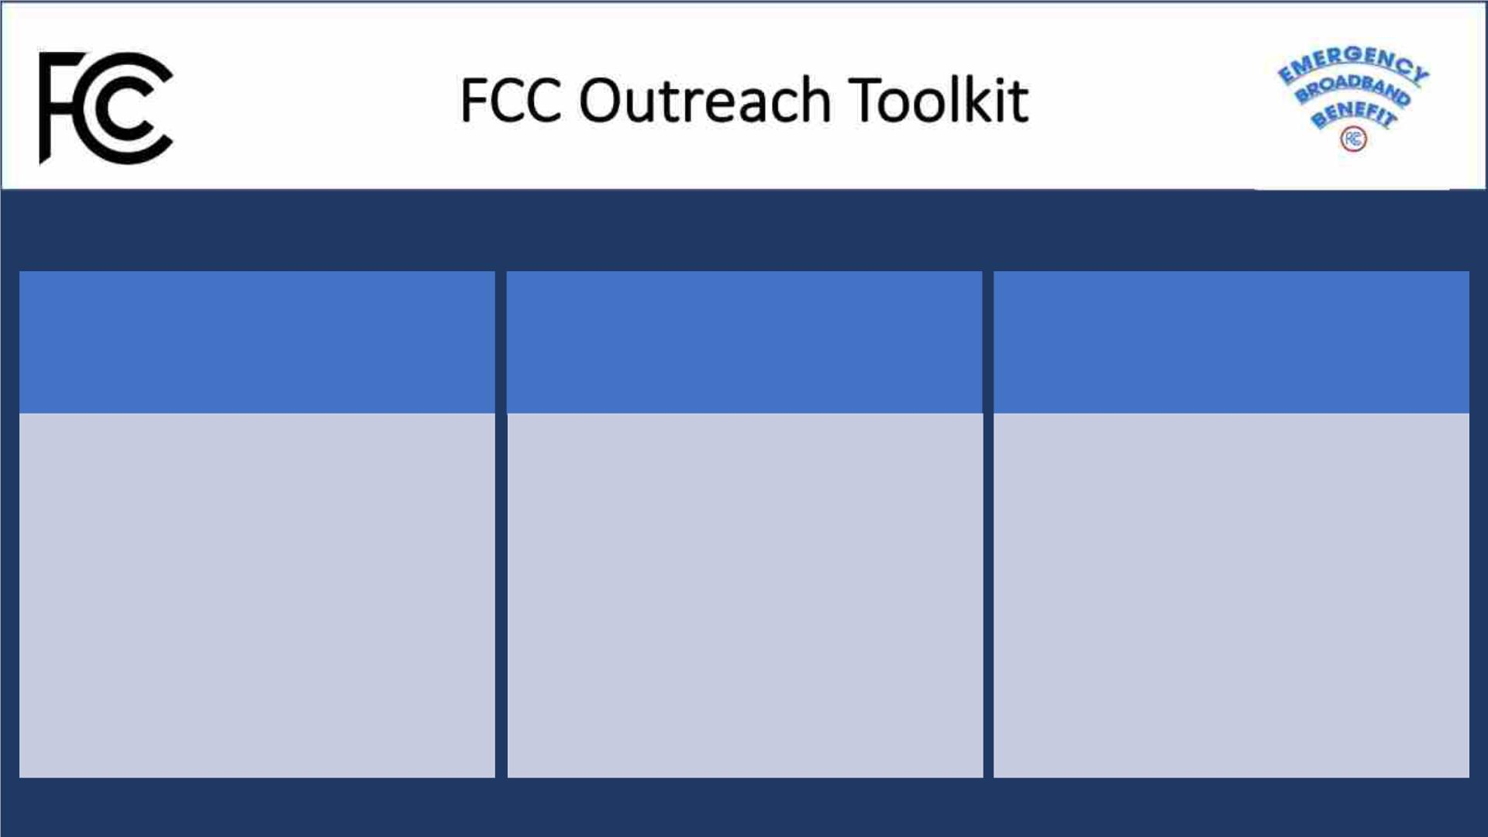
Social
Printables Videos and PSAs
Logos
Fact Sheet
ASL Video
Social Media Images
Draft Social Media Posts
Newsletter Insert
Flyer
Overview Video
How to Apply Video
Audio PSAs
9”x 5” Info Card
1/4 Page Handout
Poster/Infographic
Draft Press Release
PowerPoint Slide Deck

Slide 17
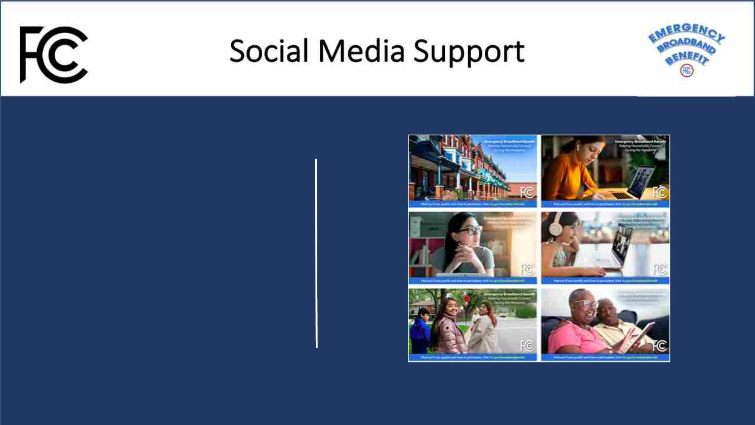
Logos
SocialꢀMediaꢀImages
DraftꢀsocialꢀMediaꢀPosts
NewsletterꢀInserts
DraftꢀPressꢀRelease

Slide 18
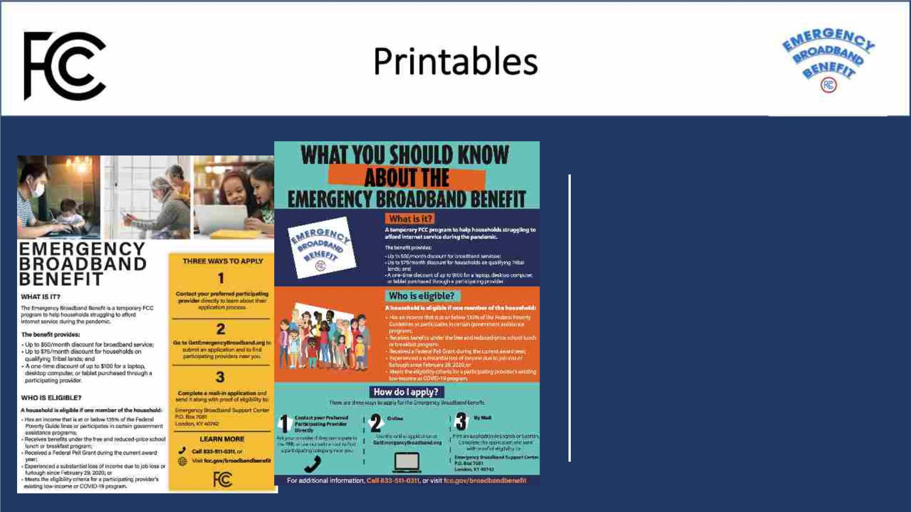
FactꢀSheet
Flyers
Poster
9"ꢀxꢀ5"ꢀInfoꢀCard
1/4ꢀPageꢀHandout
Infographic

Slide 19
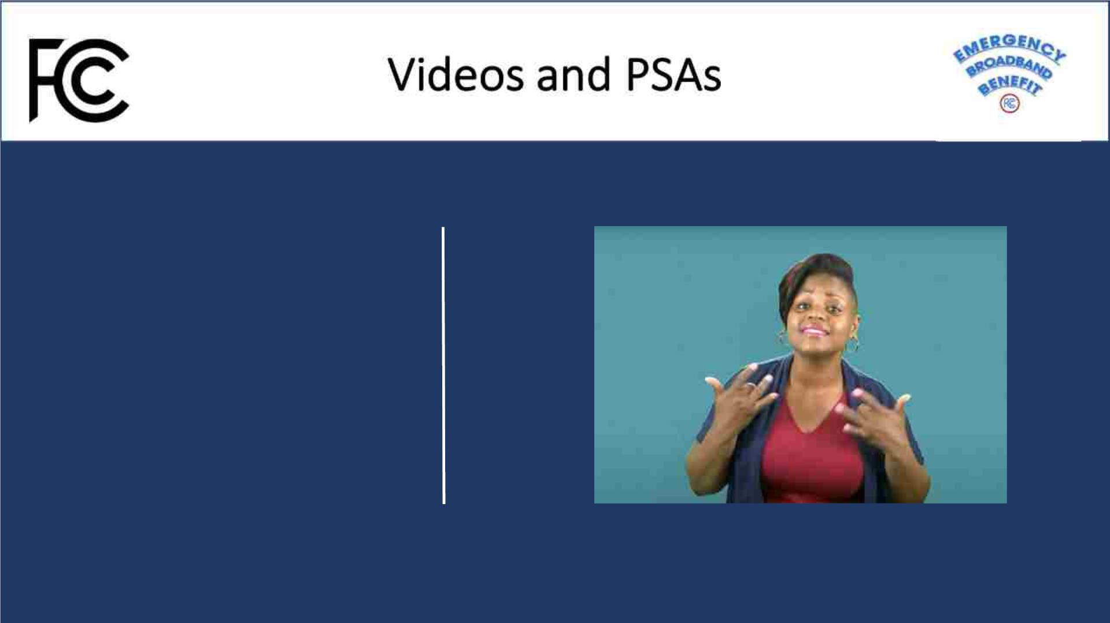
ASL Video
Overview Video
How to Apply Video
Radio PSAs
Powerpoint Slide Deck

Slide 20

TranslatedꢀLanguages TranslatedꢀMaterial
(Instructionsꢀtoꢀcompleteꢀapplication)
AlternateꢀFormats
FactꢀSheet
9"ꢀxꢀ5"ꢀInfoꢀCards
1/4ꢀPageꢀHandout
Toꢀrequestꢀmaterialsꢀinꢀ
Arabic
Chineseꢀ(Traditional)
French
accessibleꢀformatsꢀforꢀpeopleꢀ
withꢀdisabilitiesꢀ(Braille,ꢀlargeꢀ
print,ꢀelectronicꢀfiles,ꢀaudioꢀ
format),ꢀsendꢀanꢀe-mailꢀto:ꢀ
FCC504@fcc.gov.
Korean
Portuguese
Russian
Spanish
Tagalog
Vietnamese

Slide 21
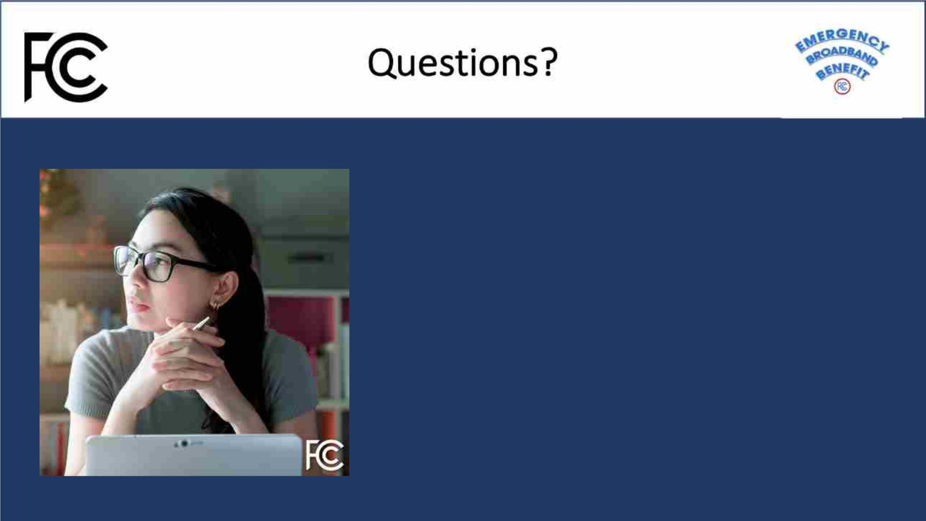
TheꢀFCC’sꢀEBBꢀConsumerꢀHub:
www.fcc.gov/broadbandbenefit
Tollꢀfreeꢀnumberꢀforꢀquestions:ꢀꢀ
833-511-0311
Toꢀapply:ꢀ
GetEmergencyBroadband.org

