Slide 1
Maryland Assistive Technology Program
Maryland Department of Disabilities
Notes:
Hello!
Thank you for that introduction, Kevin. We wanted to include some information about our sister program, MD Assistive Technology Program because what they do nicely compliments what we do at MAT and Access Hears.

Slide 2
ABOUT US
Maryland TAP provides statewide access to assistive technology (AT) through equipment demonstrations, loans, reuse, financing, and training.
www.mdtap.org

Slide 3
WhAT We Do in Maryland
- Maintain 4 (four) Regional Offices & Libraries across the state (Central Baltimore, Southern Maryland, Western Maryland, and Eastern Shore) – services include trainings, demos, loans, outreach
- Host 4 (four) additional Community AT Libraries across the state
- AT demonstrations and customized consultations with on-staff AT Clinicians – In-person and Virtually!
- Issue short-term device loans, up to 4 weeks at a time
- Host in-depth AT sessions exploring a variety of AT topics - In-person and Virtually!
Interactive Assistive Technology Access Map

Slide 4
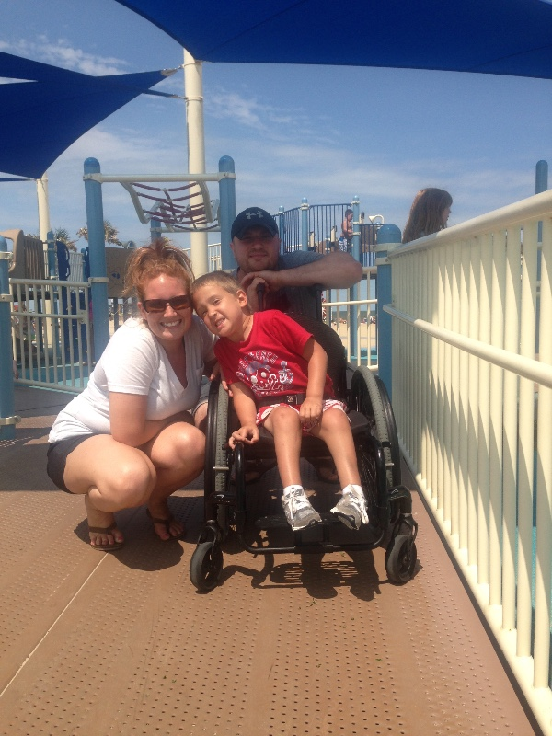
AT Financial Loan Program Snapshot
Provides low-interest loans to Maryland residents with disabilities or their families to buy assistive technology
Covers all types of AT including vehicles, computers, home modifications, and more
Interest rates between 3-4%
Loan amounts between $500-$50,000
http://mdod.maryland.gov/mdtap/Pages/AT-Financial-Loan-Program.aspx
Notes:
MDTAP has its own loan program specifically for Assistive Technology.
Interest rates are lower than the commercial banking market at 3-4% and range from as little as $500 to as much as $50,000.
Although you have to apply and qualify, they are much easier to work with than a commercial banking institute.

Slide 5
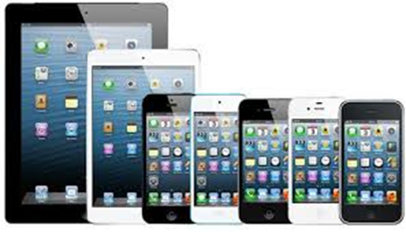
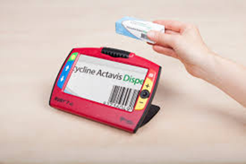
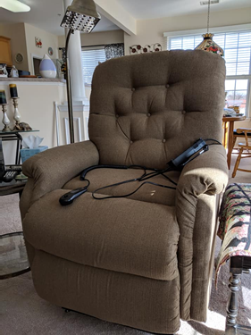
What Can I Buy With A Financial Loan?
Home modifications
Adapted & non-adapted vehicles
Scooters and wheelchairs
Braille equipment
Vision aids (CCTV’s, magnifiers, etc.)
Hearing aids
Communication devices
Smart home devices
Computers and iDevices
Recreational AT (adapted bikes, adapted gaming systems, etc.)
Many other devices
Notes:
What can you buy with an AT loan – accessibility and independence! Including hearing aids!

Slide 6
CONTACT US
Central Office
Maryland Technology Assistance Program
2301 Argonne Drive, T-42
Baltimore, MD 21218
(800) 832-4827 (voice)
(866) 881-7488 (TTY)
(410) 554-9237 (fax)
MDTAP.General@maryland.gov (e-mail)
www.mdtap.org (web)
Notes:
Here’s how you can reach the MDTAP AT specialist.

